Slide 1
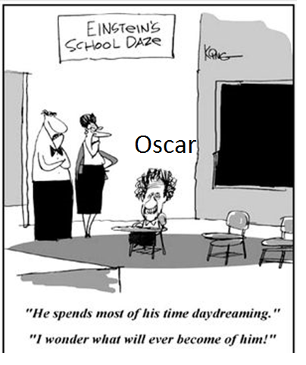
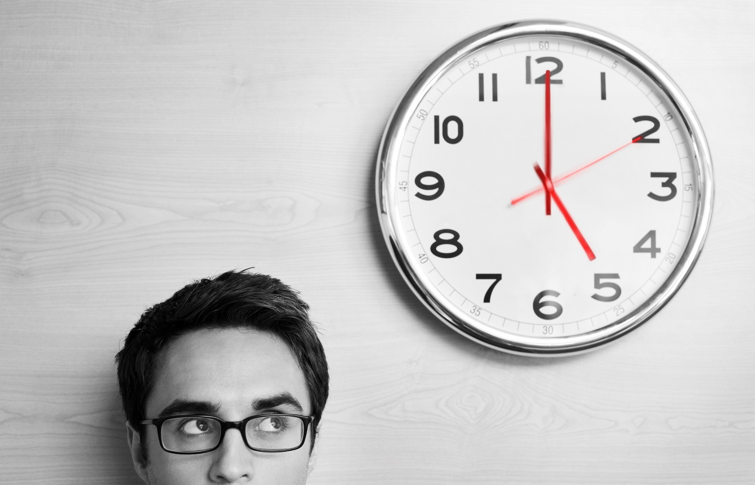
Special Relativity Calculations It’s about time!

Slide 2

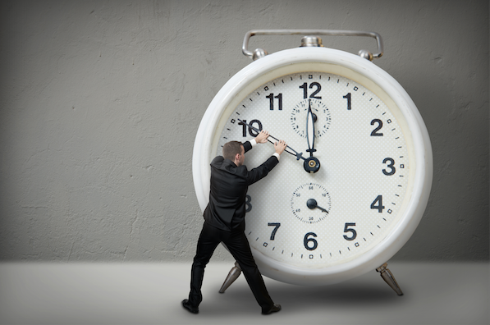
Special Relativity Review
Time Dilation Calculations

Slide 3
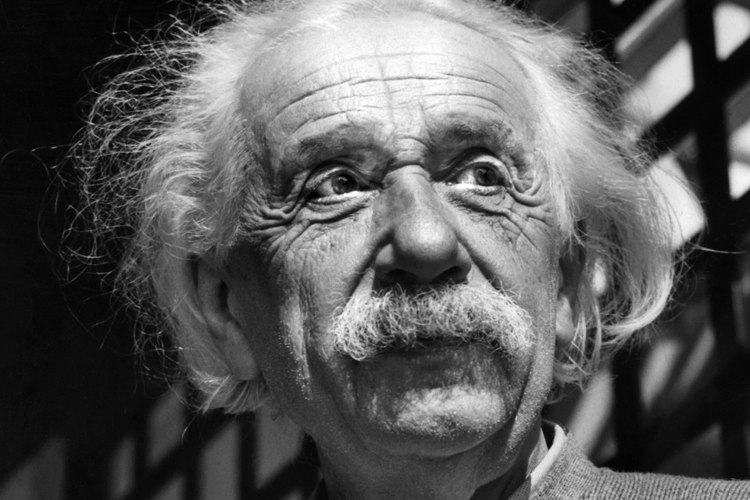
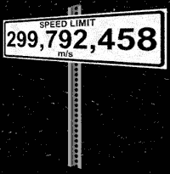
Two Postulates of Special Relativity
Einstein’s Special Theory of Relativity, published in 1905, was based on two postulates:
I. The laws of physics are the same for all frames of reference moving at a constant velocity with respect to each other.
II. The velocity of light in a vacuum c is constant for all observers, independent of their state of motion. (c = 3.00 x 10⁸ ms⁻¹)

Slide 4
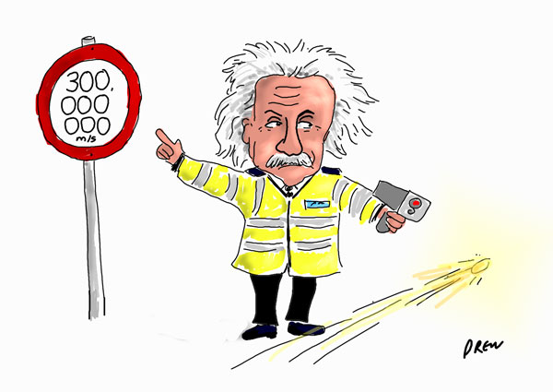
Time Dilation
Special relativity tells us that the only constant is the speed of light.
This means that both time and space become variable, depending on the reference frame of an observer.

Slide 5
Simultaneity
The judgment of simultaneous events is also a matter of relativity.
Observers in different inertial reference frames WILL NOT agree that the same two events are simultaneous.
This means that the perceived time between any two events is also dependent on your frame of reference relative to those events.

Slide 6
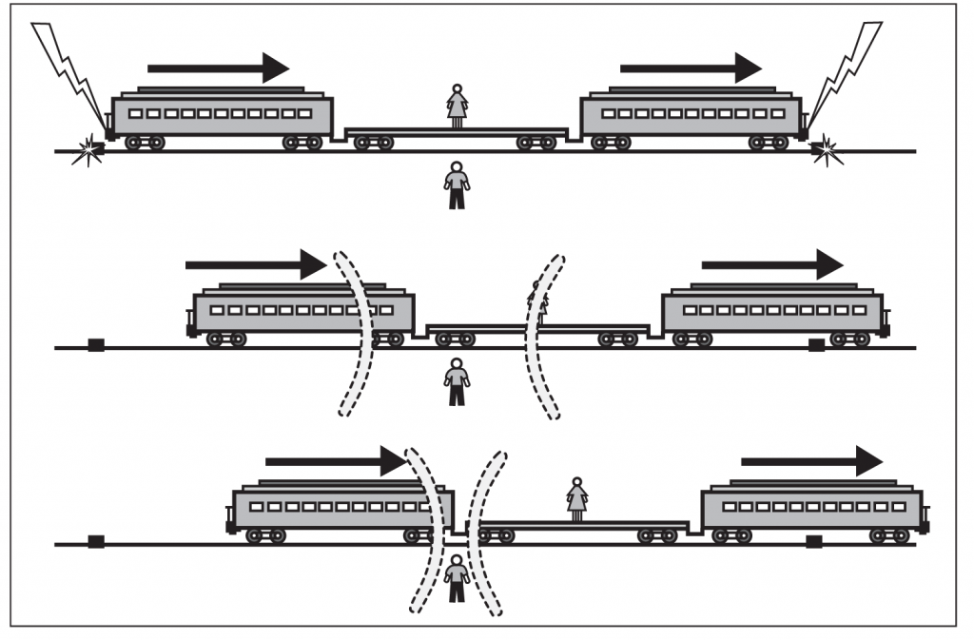
Simultaneity
A man is standing at the midpoint of a train station. A woman is standing in the middle of a train that is travelling at relativistic speeds.
As the train passes the station, at the exact moment in time that the woman passes the man, bolts of lightning strike each end of the platform.
If the lightning bolts appear to be simultaneous for the man on the platform, what will the woman see?

Slide 7
Simultaneity
The woman will see the lightning bolt she is moving towards first, and the second lightning bolt some time later as she is moving away from it.
In the diagram, the woman sees the right bolt first as she is moving towards it, and sees the left bolt at a later time as she is moving away from it.)
Note that although both observers would disagree with the timing of the bolts, they are correct in their respective inertial frame.

Slide 8
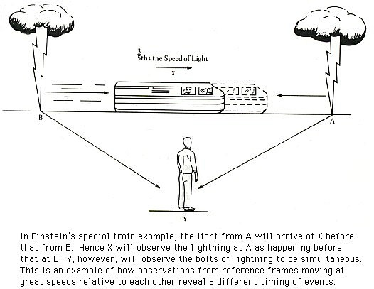
Simultaneity
Videos\1. Simultaneity

Slide 9
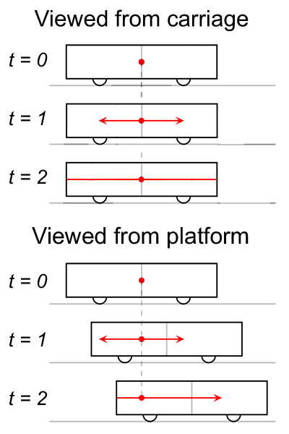
Simultaneity
A light originating from the middle of a relativistic train hits both ends of the train simultaneously from the perspective of an observer in the carriage.
An observer outside the train sees it hit the back wall first, because the back wall moves forward towards the oncoming light.

Slide 10
Time Dilation Equation
SR and Twin Paradox
Einstein’s Time dilation Equation:
Δt = Relative time (Time measured in frame moving relative to actual event being observed).
Δt_{o}= Proper time (Time measured in the same frame as the event itself).
v = Relative velocity of two frames.
c = Free space velocity of light (c = 3 x 10⁸ m/s).

Slide 11
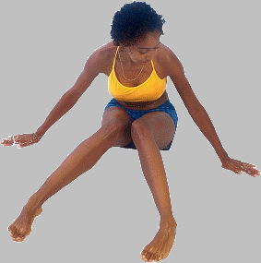

Time Dilation Equation
The key to applying the time dilation equation is to distinguish clearly between proper time Δt_{o} and relative time Δt. See → example below:
Event Frame
Relative Frame
d
Δt_{o}
Δt
Proper Time
Relative Time
Δt > Δt_{o}

Slide 12
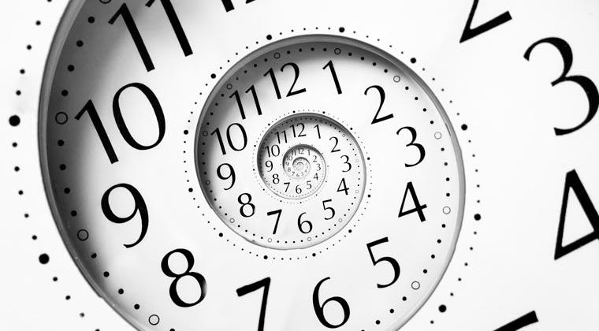


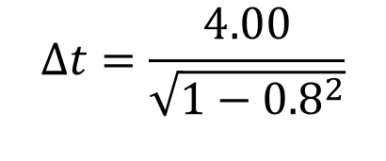
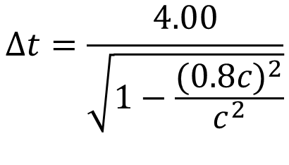
Time Dilation Example
Ship A passes ship B with a relative velocity of 0.8c (eighty percent of the velocity of light). A woman aboard Ship B takes 4 s to walk the length of her ship. What time is recorded by the man in Ship A?
$$∆t=\frac{4.00}{\sqrt{1−\frac{{(0.8c)}^{2}}{c^{2}}}}$$
A
$$∆t=\frac{4.00}{\sqrt{1−{0.8}^{2}}}$$
B
v = 0.8c
$$∆t=6.67 s$$

Slide 13

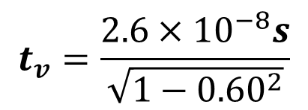
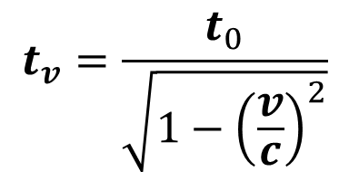
Time Dilation Example 2
The pi meson, an unstable particle is produced in a particle accelerator. A pi meson lives on average about 2.6x10⁻⁸s (measured in its own frame of reference) before decaying. If such a particle is moving with a constant speed of 0.60c, what lifetime is measured by researchers studying it?
$$t_{v}=\frac{t_{0}}{\sqrt{1−{\left(\frac{v}{c}\right)}^{2}}}$$
$$t_{v}=\frac{2.6×{10}^{−8}s}{\sqrt{1−{0.60}^{2}}}$$
$$t_{v}=3.25×{10}^{−8}s$$

Slide 14
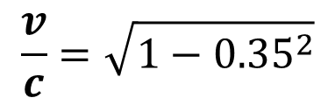
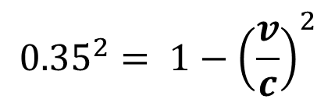
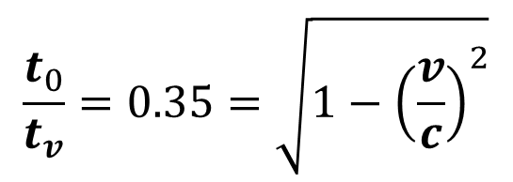
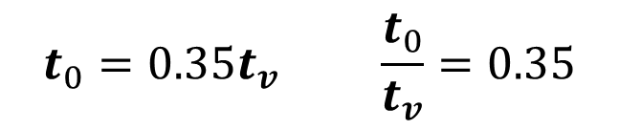

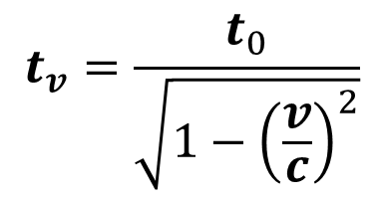
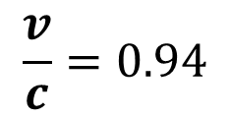
Time Dilation Example 3
What speed would a clock have to be moving in order to run at 35% of the rate of a clock at rest from outside the reference frame.
$$t_{0}=0.35t_{v} \frac{t_{0}}{t_{v}}=0.35$$
$$t_{v}=\frac{t_{0}}{\sqrt{1−{\left(\frac{v}{c}\right)}^{2}}}$$
$$\frac{v}{c}=\sqrt{1−{0.35}^{2}}$$
$$\frac{t_{0}}{t_{v}}=0.35=\sqrt{1−{\left(\frac{v}{c}\right)}^{2}}$$
$$\frac{v}{c}=0.94$$
$$v=0.94c$$
$${0.35}^{2}= 1−{\left(\frac{v}{c}\right)}^{2}$$

Slide 15

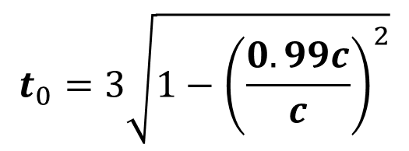
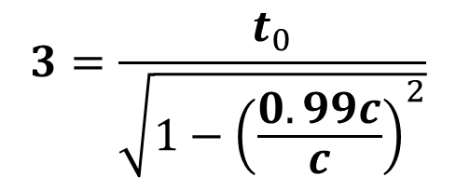

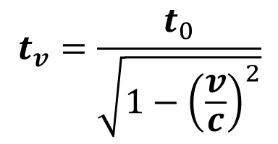
Time Dilation Example 4
A spaceship travels at 0.99c for 3 years as measured by ship time. How much time would pass on the Earth from the perspective of the crew?
$$t_{v}=\frac{t_{0}}{\sqrt{1−{\left(\frac{v}{c}\right)}^{2}}}$$
$$t_{0}=? t_{v}=3 years$$
$$3=\frac{t_{0}}{\sqrt{1−{\left(\frac{0.99c}{c}\right)}^{2}}}$$
$$t_{0}=3\sqrt{1−{\left(\frac{0.99c}{c}\right)}^{2}}$$
$$t_{0}=0.423 years$$

Slide 16
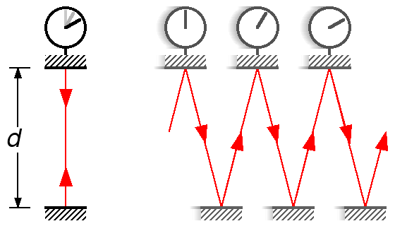
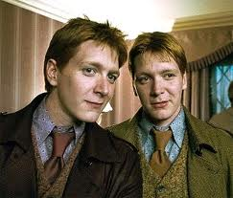
Twin Paradox
Fred and George are identical, and so have identical life-spans. They each have a light clock.
This light clock “ticks” once every millisecond, so they both expect to observe 2.5 × 10¹² ticks in their 80 year life-span.

Slide 17
Twin Paradox
Fred flies on his Nimbus 2000 broomstick to the right at 20% of the speed of light. George stays on the ground.
Fred
Over his life, George sees 2.5 × 10¹² ticks of his stationary clock.
How many “ticks” of Fred’s clock does George observe?
More than 2.5 × 10¹²
Fewer than 2.5 × 10¹²
2.5 × 10¹²
George

Slide 18
Twin Paradox
Fred flies on his Nimbus 2000 broomstick to the right at 20% of the speed of light. George stays on the ground.
Fred
After George sees 2.5 × 10¹² ticks of his stationary clock, he dies of old age. Will Fred see his twin brother die?
Maybe … Fred will also probably die at the same time.
Yes…..Fred has more life to live.
No ….Fred has already been dead for some time.
George

Slide 19
